Slide 1
Anomaly Detection

Slide 2
What are anomalies/outliers?
What is anomaly detection?
Types of Data
Univariate vs. Multivariate data
Statistical Approaches – outliers detection
Parametric vs. non-Parametric
Non-Parametric Univariate Tests
Interquartile Range – IQR
Isolation Forest

Slide 3
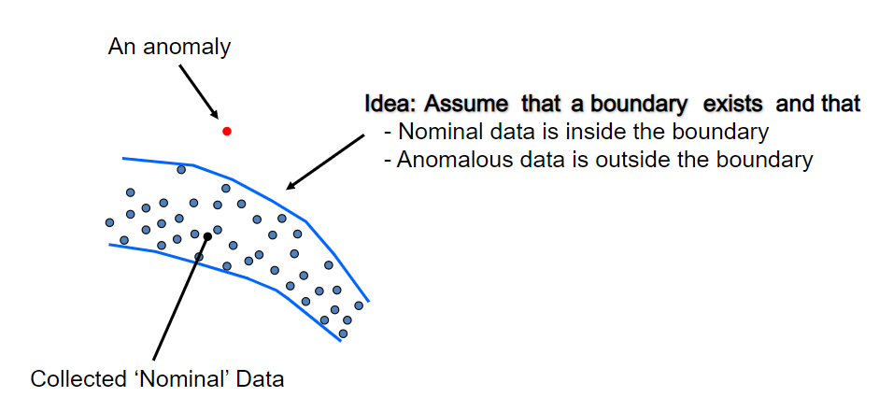
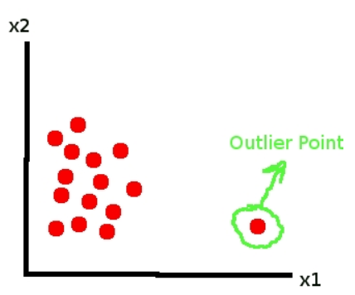
Anomalies/Outliers
What is anomaly or outlier?
Set of data points or observations which deviate from rest of the data

Slide 4
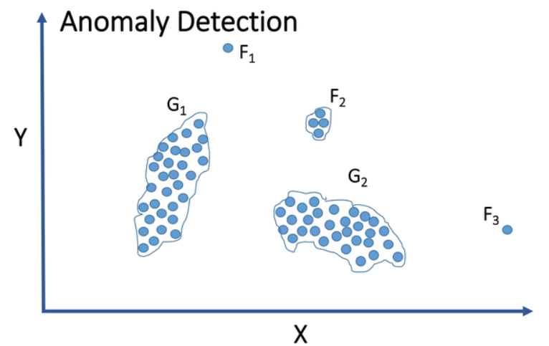
Anomaly Detection
Anomaly detection is the process of identifying data points, events, and/or observations that deviate from the dataset's normal behavioral patterns.

Slide 5
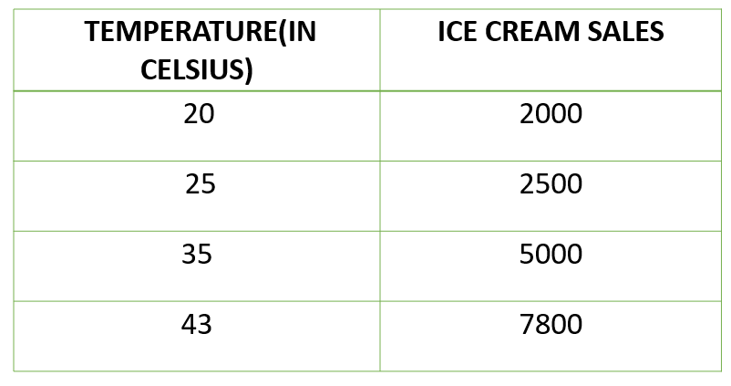
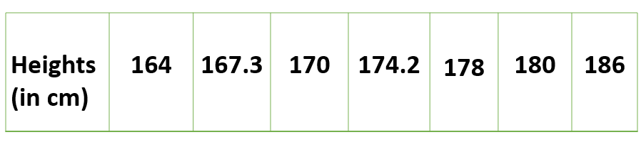
Data Types
Types of Data Variables
Univariate
The data being analyzed contains only one variable. Since it's a single variable it doesn’t deal with causes or relationships
Multivariate
The data being analyzed contains more than one variables. It tries to establish a relationships between multiple data sets.

Slide 6
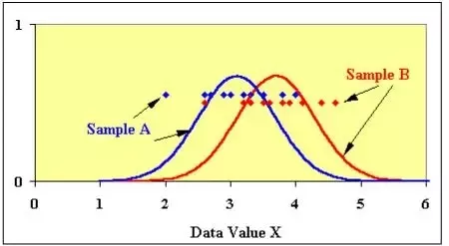
Statistical Approaches – Outlier detection
Parametric tests assume underlying statistical distributions in the data. Therefore, several conditions of validity must be met so that the result of a parametric test is reliable.
Nonparametric tests do not rely on any distribution. They can thus be applied even if parametric conditions of validity are not met.

Slide 7
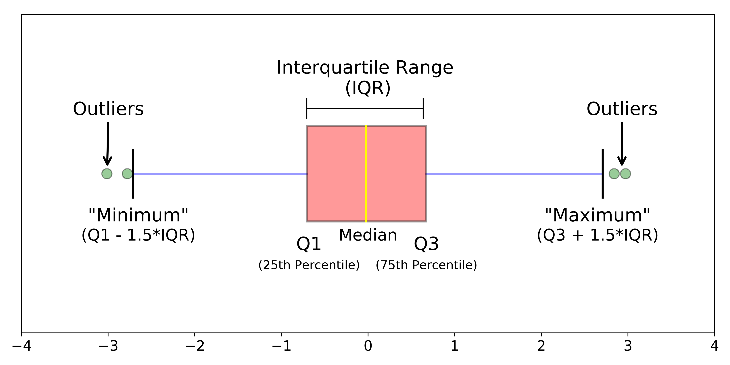
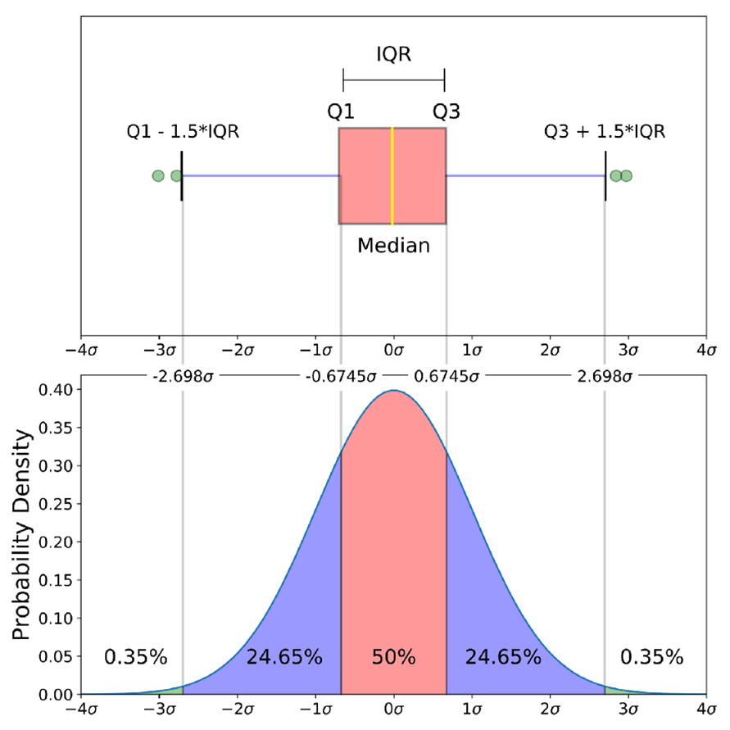
Nonparametric Test (Outlier detection)
Interquartile Range (IQR)
When a data set has outliers or extreme values, The interquartile range is often used to find outliers in data.
The IQR is a measure of variability, based on dividing a data set into quartiles, which is the difference between the first and third quartiles.
IQR is also called the middle 50%, which equals to the difference between 75th and 25th percentiles, or between upper and lower quartiles, IQR = Q₃ − Q₁

Slide 8
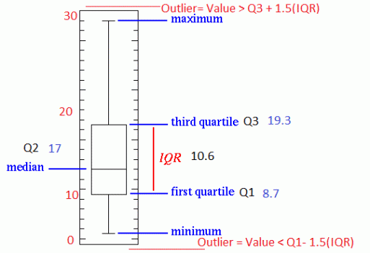
Nonparametric Test – Outlier detection
Interquartile Range (IQR) - Example (box plot)
IQR = Q3- Q1
How to calculate IQR and find outliers
Step 1: Order from low to high
Step 2: Find the median or in other words Q2
Step 3: Then find Q1 by looking the median of the left side of Q2
Step 4: Similarly find Q3 by looking the median of the right of Q2
Step 5: Now subtract Q1 from Q3 to get IQR.
As a rule of thumb, observations can be qualified as outliers when they lie more than 1.5 IQR below the first quartile or 1.5 IQR above the third quartile.
Outliers = Q1 – 1.5* IQR OR Q3 + 1.5*IQR

Slide 9
Nonparametric Test – Outlier detection
Interquartile Range (IQR) - Example (box plot)
IQR = Q3- Q1
How to calculate IQR and find outliers
Step 1: Order from low to high
Step 2: Find the median or in other words Q2
Step 3: Then find Q1 by looking the median of the left side of Q2
Step 4: Similarly find Q3 by looking the median of the right of Q2
Step 5: Now subtract Q1 from Q3 to get IQR.
As a rule of thumb, observations can be qualified as outliers when they lie more than 1.5 IQR below the first quartile or 1.5 IQR above the third quartile.
Outliers = Q1 – 1.5* IQR OR Q3 + 1.5*IQR

Slide 10
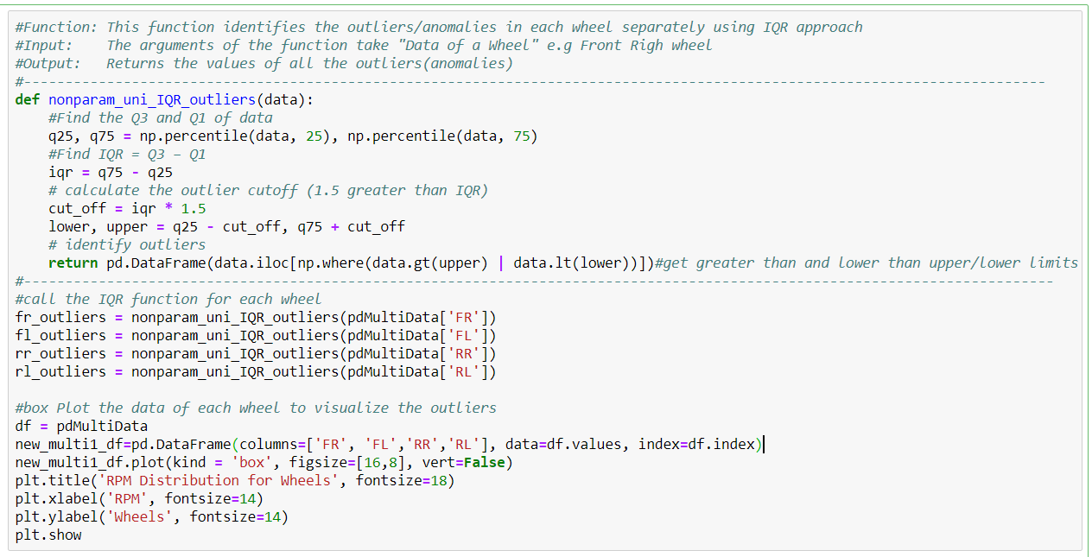
Nonparametric Test – Outlier detection
Interquartile Range (IQR) –
Implementation using Python

Slide 11
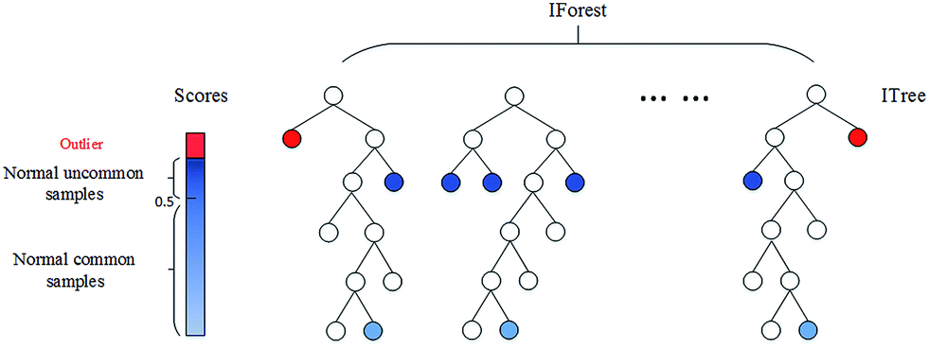
Nonparametric Test – Outlier detection
Isolation Forest
This is a nonparametric method for large datasets in a one or multi-dimensional feature space.
Identifies anomalies instead of normal observations & returns the anomaly score of each sample.
A tree-based model. In these trees(partitions) are created randomly for a given data set, and anomalies are the paths with shortest average path length.

Slide 12
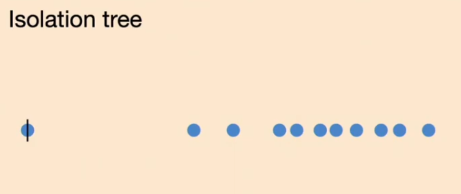
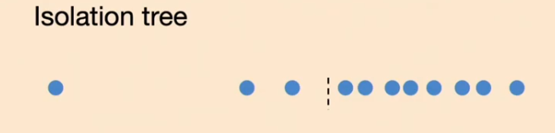
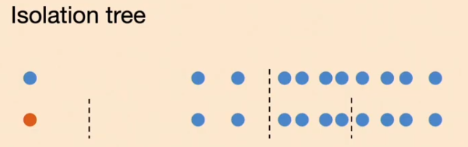
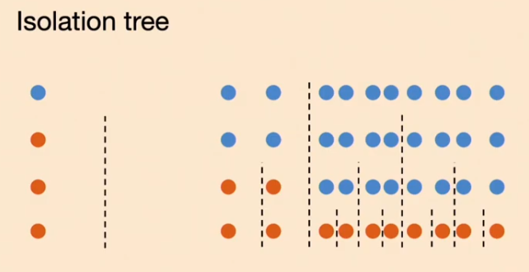
Nonparametric Test – Outlier detection
Isolation Forest – How it works?
Select the point to isolate.
For each feature, set the range to isolate between the minimum and the maximum.
Choose a feature randomly.
Pick a value that’s in the range, again randomly:
If the chosen value keeps the point above, switch the minimum of the range of the feature to the value.
If the chosen value keeps the point below, switch the maximum of the range of the feature to the value.
Repeat steps 3 & 4 until the point is isolated. That is, until the point is the only one which is inside the range for all features.
Count how many times you’ve had to repeat steps 3 & 4. We call this quantity the isolation number.

Slide 13

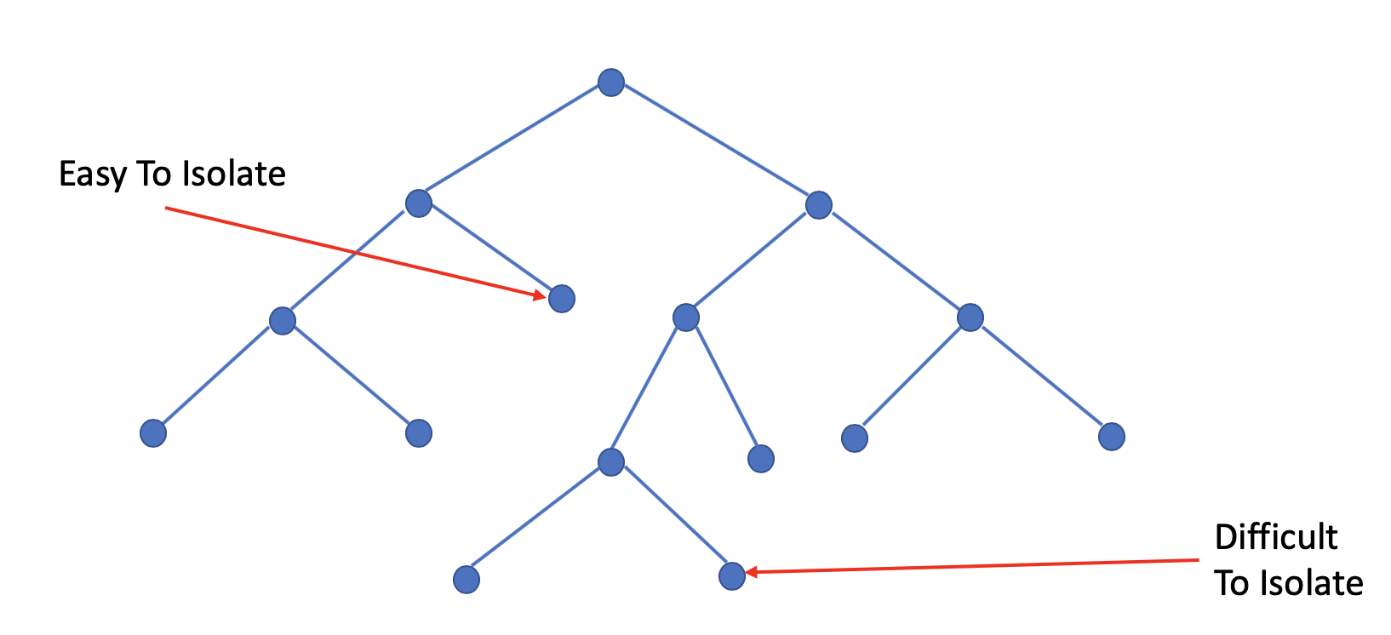
Nonparametric Test – Outlier detection
Isolation Forest – How it works?
An important concept in this method is the isolation number.
It is the number of splits needed to isolate a data point.
A data point is defined as an outlier if its isolation number is lower than the threshold.
An outlier score can computed for each observation:
Where
h(x) is the path length of the sample x,
c(n) is the the maximum path length of a binary tree from root to external node
n is the number of external nodes.
After giving each observation a score ranging from 0 to 1; 1 meaning more outlier and 0 meaning more normality. A threshold can be specified (ie. 0.55 or 0.60)

Slide 14
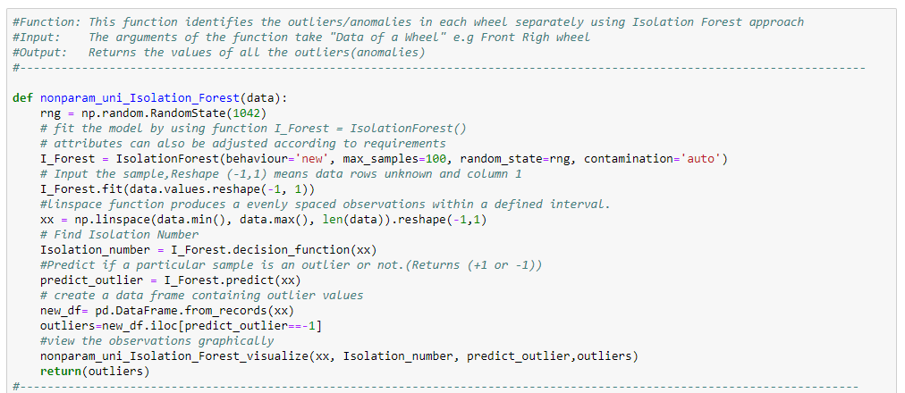
Nonparametric Test – Outlier detection
Isolation Forest –
Implementation using Python

Slide 15
References
http://www.erogol.com/anomaly-detection-and-a-simple-algorithm-with-probabilistic-approach/
https://www.quora.com/Can-reinforcement-learning-be-used-for-anomaly-detection
https://medium.com/@alhadpofali_5697/anomaly-and-outlier-detection-concepts-1f82498851a2
https://medium.com/@mehulved1503/outlier-detection-and-anomaly-detection-with-machine-learning-caa96b34b7f6
https://en.wikipedia.org/wiki/Interquartile_range
http://sphweb.bumc.bu.edu/otlt/mph-modules/bs/bs704_summarizingdata/bs704_summarizingdata7.html
http://makemeanalyst.com/explore-your-data-range-interquartile-range-and-box-plot/
https://dzone.com/articles/four-techniques-for-outlier-detection-knime
https://towardsdatascience.com/a-brief-overview-of-outlier-detection-techniques-1e0b2c19e561
https://dzone.com/articles/spotting-outliers-with-isolation-forest-using-skle
https://www.analyticsvidhya.com/blog/2019/02/outlier-detection-python-pyod/
https://quantdare.com/isolation-forest-algorithm/
https://medium.com/walmartlabs/swamping-and-masking-in-anomaly-detection-how-subsampling-in-isolation-forests-helps-mitigate-bb192a8f8dd5
https://www.youtube.com/watch?v=RyFQXQf4w4w (Isolation Tree)
https://dzone.com/articles/spotting-outliers-with-isolation-forest-using-skle
https://towardsdatascience.com/anomaly-detection-for-dummies-15f148e559c1
https://towardsdatascience.com/anomaly-detection-with-isolation-forest-visualization-23cd75c281e2

Slide 18
Genia cuptata riatio: Nulpa se percim noneque coressi mendum quut et aute latemporem la quassimus, est, voluptasimod et esto id et, cum incte voles verisim inctlet
List item 1
List item 2
List item 3

